Slide 1


Movies Recommendation System

Slide 2

Introduction to Recommendation Systems
Why recommendation systems are crucial in today's digital landscape (e.g., personalized content delivery, enhancing user experience).

Slide 3
Problem Statement
Challenge:
In an era where content consumption is at an all-time high, users are often overwhelmed with choices. This abundance makes it difficult for users to find movies that align with their personal tastes.
Objective:
Develop a recommendation system that can suggest movies to users based on their viewing history and preferences. The goal is to provide a personalized list of movie recommendations that are likely to match the user's interests.

Slide 4

Dataset
Data Source:
The dataset was sourced from [mention the source, e.g., a public movie database or a dataset provided for the project].
Key Features:
Movie Titles: Unique identifiers for each movie.
Genres: Categories that describe the movie’s content (e.g., Action, Comedy, Drama).
User Ratings: Numerical ratings given by users (if applicable).
Metadata: Additional information such as directors, actors, or release year (if used).
Data Preprocessing:
Cleaning: Removed duplicates and handled missing values to ensure data quality.
Normalization: Standardized data formats for consistent processing.
Feature Selection: Selected relevant features that directly impact movie similarity calculations.

Slide 5

Approach
Algorithm Choice:
Cosine Similarity: Selected as the primary method to measure similarity between movies. This approach is ideal for identifying items that are similar in terms of attributes like genres or user ratings.
Why Cosine Similarity?
Vector Representation: Movies are represented as vectors in a multi-dimensional space where each dimension corresponds to a feature (e.g., genre).
Angle Measurement: Cosine similarity calculates the cosine of the angle between two vectors. A smaller angle (closer to 1) indicates higher similarity.
Feature Independence: The magnitude of the vectors (e.g., number of ratings) doesn’t affect the similarity, making cosine similarity robust for comparing movies with varying levels of popularity.
Process:
Data Preparation: Convert movie features into vector form.
Similarity Calculation: Compute the cosine similarity between the target movie and all other movies in the dataset.
Recommendation: Rank movies based on their similarity scores and recommend the top N movies.

Slide 6
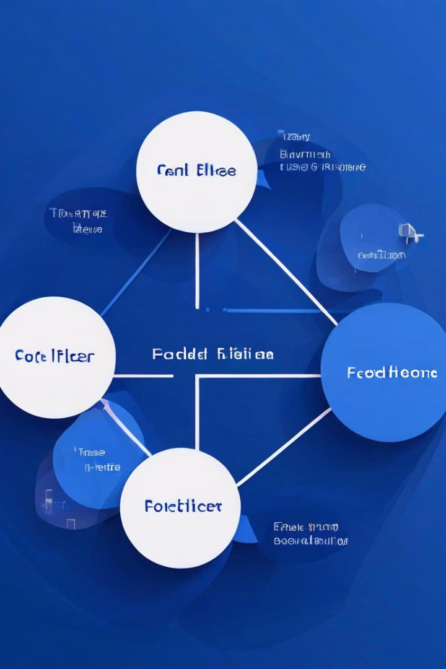
Implementation
Libraries Used:
Pandas: Utilized for data manipulation and handling large datasets efficiently.
Numpy: Leveraged for numerical operations, especially in calculating cosine similarity between movie vectors.
Code Overview:
Data Loading: Imported the dataset and performed initial preprocessing using Pandas (e.g., cleaning, feature extraction).
Vectorization:
Converted movie features such as genres into numerical vectors.
Each movie was represented as a vector in a multi-dimensional space, where dimensions correspond to features.
Cosine Similarity Calculation:
Cosine Similarity=A⋅B / ∥A∥∥B∥
where A and B are the feature vectors of two movies.
Used Numpy to calculate the cosine similarity between the target movie and every other movie in the dataset.
The formula used:

Slide 7
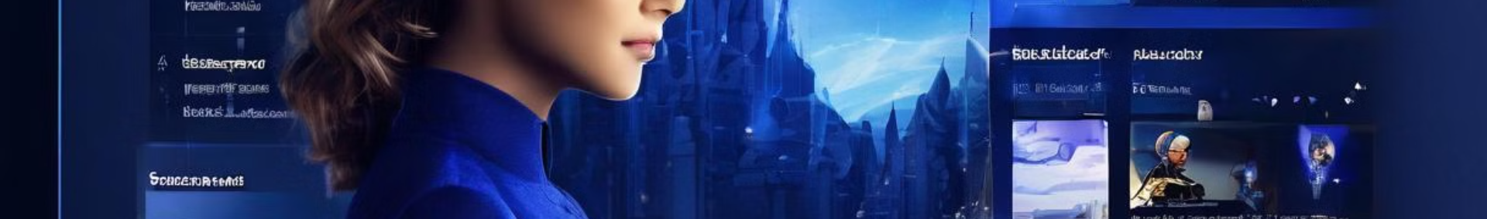
Results
Sample Recommendations:
Example 1: If a user likes The Matrix (Sci-Fi, Action), the system recommends:
Godzilla: King of the Monsters (Sci-Fi, Thriller)
Edge of Tomorrow (Sci-Fi, Neo-noir)
Venom (Action, Sci-Fi)
Example 2: If a user enjoys The Godfather (Crime, Drama), the system suggests:
Goodfellas (Crime, Drama)
The Shawshank Redemption (Crime, Drama)
Finding Steve McQueen (Crime, Thriller)
Accuracy:
Evaluation: While cosine similarity is effective in finding similar movies, no formal accuracy metrics were calculated due to the subjective nature of movie recommendations.
User Feedback: Initial tests indicate that the system provides relevant and diverse recommendations, aligning with user expectations.
Insights:
Diversity in Recommendations: The system not only recommends movies of the same genre but also considers movies with overlapping themes or styles, enhancing user satisfaction.
Scalability: The approach works well for large datasets, allowing for quick and efficient generation of recommendations.

Slide 8

Challenges
Technical Challenges:
Data Sparsity:
Handling sparse data, especially in cases where certain features (e.g., genres) were not well-represented across all movies.
Overcoming this required careful preprocessing and feature engineering to ensure meaningful similarity calculations.
Computational Complexity:
Calculating cosine similarity across a large dataset was computationally intensive, especially as the number of movies and features increased.
This was managed by optimizing data structures and utilizing efficient libraries like Numpy.

Slide 9
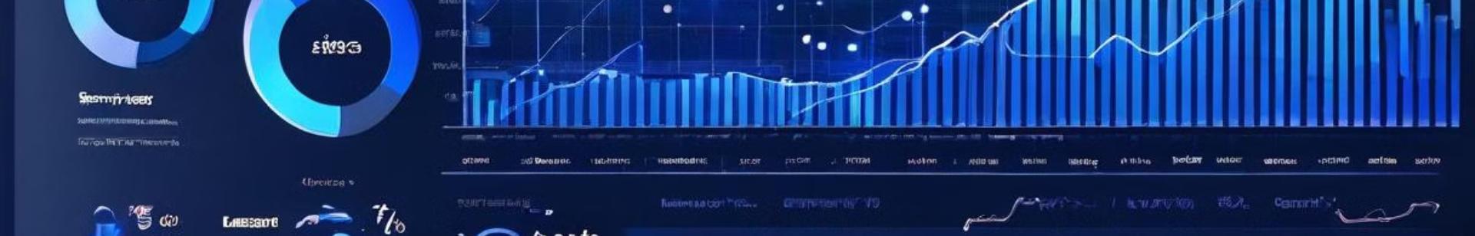
Future Work
Improvements:
Incorporate User Ratings:
Integrate user ratings to enhance recommendations by considering both movie content and user preferences. This could involve combining content-based filtering (cosine similarity) with collaborative filtering methods.
Hybrid Recommendation System:
Develop a hybrid system that combines content-based and collaborative filtering techniques to provide more accurate and personalized recommendations.
Advanced Algorithms:
Experiment with more sophisticated similarity measures or machine learning algorithms, such as:
Matrix Factorization (e.g., SVD): To uncover latent features that better represent user preferences.
Deep Learning Models: Use neural networks to capture complex relationships between movies.

Slide 10
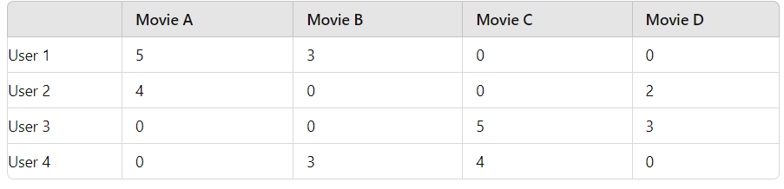
SVD
A = U⋅Σ⋅V.T
U: The user matrix, where each row corresponds to a user, and each column corresponds to a latent feature.
Σ: A diagonal matrix containing singular values, which represent the importance or strength of each latent feature.
V.T: The transpose of the item matrix, where each column corresponds to an item, and each row corresponds to a latent feature.
How SVD Works in Practice
Decomposing the Matrix: The SVD algorithm decomposes the user-item matrix into U, Σ, and V.T.
Latent Feature Representation:
Each user is represented as a vector in a latent feature space (from matrix U).
Each item (movie) is represented as a vector in the same latent feature space (from matrix V.T).
The singular values in Σ scale these latent features according to their importance.
Predicting Missing Values :
To predict the rating a user might give to an unrated movie, you take the dot product of the user's latent feature vector (from 𝑈) and the movie's latent feature vector (from 𝑉.𝑇 ), scaled by the singular values in Σ.
This prediction represents the "reconstructed" rating the user would give to the movie.

Slide 11

Conclusion
Summary:
Project Recap: This project involved developing a movie recommendation system using pandas, numpy, and cosine similarity. The system successfully recommends movies by identifying similarities in content, providing users with personalized suggestions.

